Slide 1
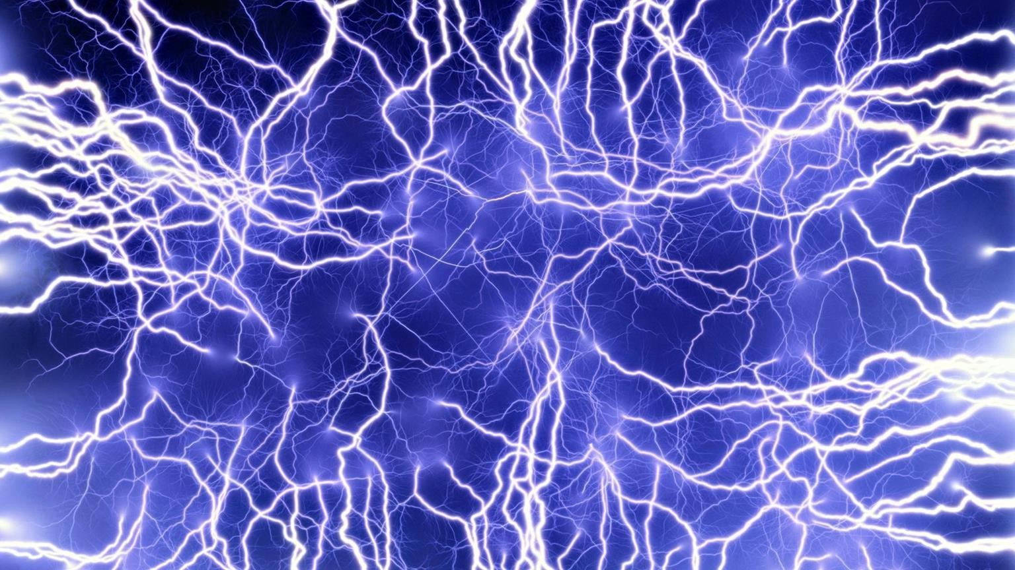


DARRELL ER (COPYRIGHTED) ©
DARRELL ER (COPYRIGHTED) ©
TOPIC 4: ELECTROLYSIS
1

Slide 2
DARRELL ER (COPYRIGHTED) ©
THE ABOUT
Very difficult chapter
4 electrolytic cell set-up
1 simple electric cell set-up
TIME
CHAPTER ANALYSIS
Usually tested in both MCQ & Paper 2
Will need prior knowledge from other chapters: Oxidation & Reduction, Chemical Equations
EXAM
Medium overall weightage
Constitute to 4% of marks for past 5 year papers
WEIGHTAGE
2

Slide 3
USING REACTIVE ELECTRODE
DARRELL ER (COPYRIGHTED) ©
Chapter Overview
This is probably one of the most difficult chapter in ‘O’ Level Chemistry.
4 ions present
Selectively discharged
Electroplating can occur if object is placed at cathode as metal cations would deposit itself onto the object
So let’s break down the chapter first before proceeding.
ELECTROLYSIS
& ELECTRIC CELL
MOLTEN
Only 2 ions present
Both ions will definitely be discharged
DILUTE
4 ions present
Selectively discharge based on ease of discharge
CONCENTRATEDSIMPLE ELECTRIC
CELL
Use chemical reaction to produce electricity
Require 2 metals of differing reactivity
Does not require electric source
4 ions present
Cation follows normal ease of discharge
Anion follows ‘concentrated’ ease of discharge
3

Slide 4

DARRELL ER (COPYRIGHTED) ©
KEY CONCEPT
All of the 4 scenarios falls under electrolytic cell.
Let’s aim to get our basics right!
ELECTROLYTIC CELL MOLTEN IONIC COMPOUND AQUEOUS IONIC COMPOUND
CONCENTRATED IONIC COMPOUND ELECTROPLATING
4

Slide 5
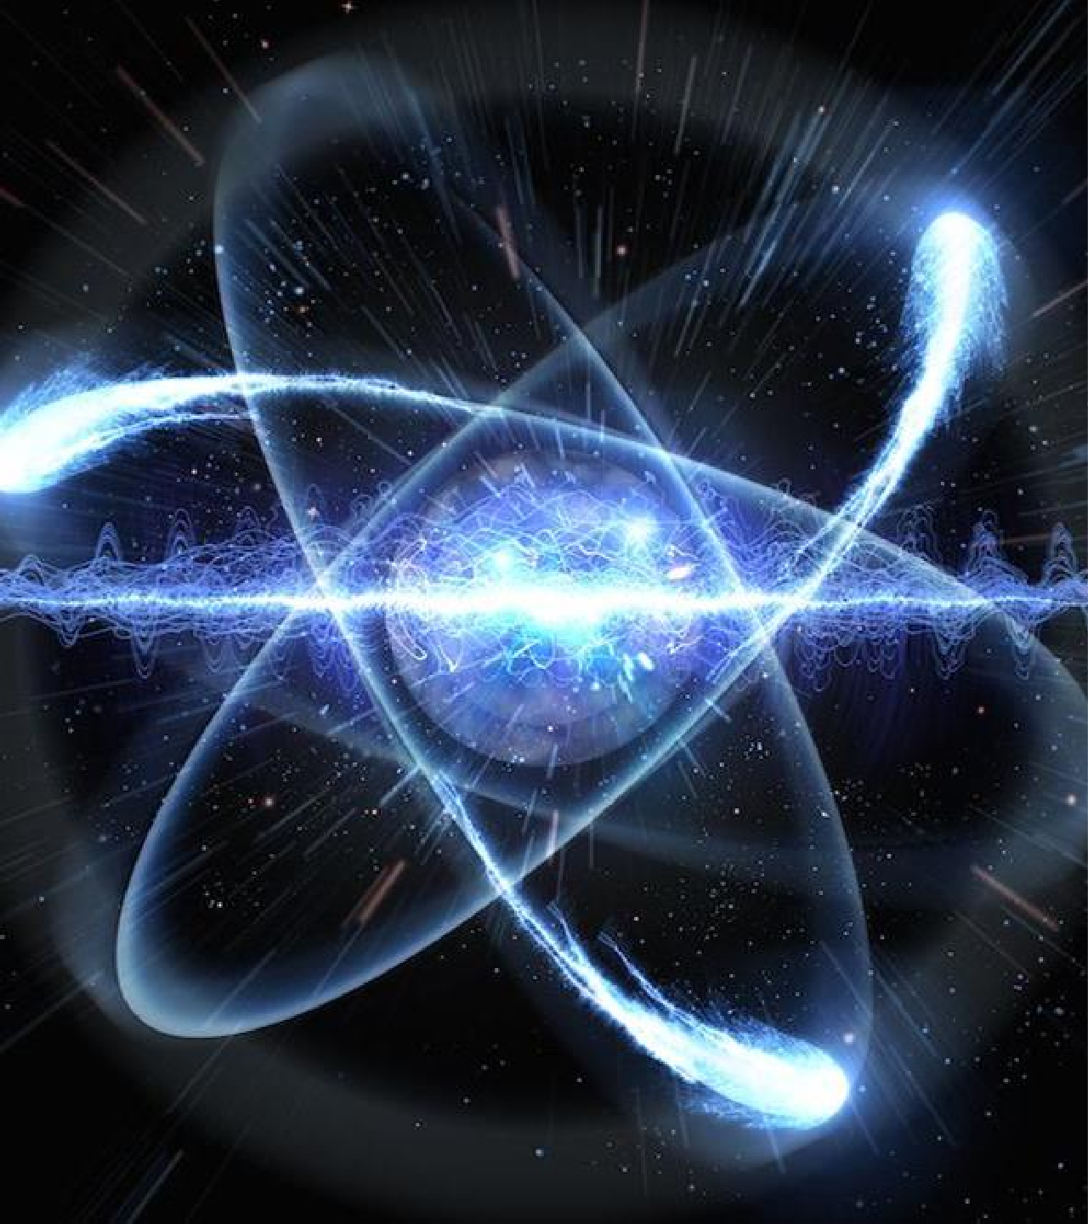
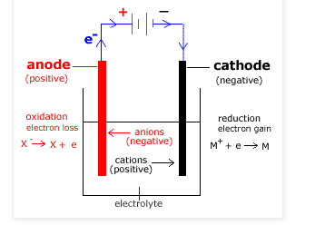
ELECTROLYTIC CELL
DARRELL ER (COPYRIGHTED) ©
LECTROLYTIC CELL
An electrolytic cell is the set-up used for electrolysis.
Key components:
Electrolyte is the ionic compound, either in its molten or aqueous state, that would dissociate into ions when a current is passed through it.
Electrodes are made of a conductive material. For inert electrodes, it is usually made of lead or platinum.
Anode is the positively-charged electrode that is connected to the positive terminal of the electrical source. (Anode is positively charged & attracts anions, hence its called ‘anode’.)
Cathode is the negatively-charged electrode that is connected to the negative terminal of the electrical source. (Cathode is negatively charged & attracts cations, hence its called ‘cathode’.)
Battery/power source causes electrons to always flow from the anode to the cathode. (For those who take physics, under ‘electricity’, recall that electron flow is from the negative terminal to the positive terminal of the battery.)
5

Slide 6

DARRELL ER (COPYRIGHTED) ©
ELECTROLYTIC CELL
ELECTROLYTIC CELL
Anode is the positively-charged electrode, as it is connected to the positive terminal of the battery.
During electrolysis, anions are attracted to the positively charged anode.
Anions are negatively charged and are looking to lose electrons to become neutral.
Hence, as anions lose electrons at the anode, they undergo
oxidation.
Cathode is the negatively-charged electrode, as it is connected to the negative terminal of the battery.
During electrolysis, cations are attracted to the negatively charged anode.
Cations are positively charged and are looking to gain electrons to become neutral.
Hence, as cations gain electrons at the cathode, they undergo
reduction.
I advise all students to try and understand this concept rather than memorising.
Try and understand the logic. Opposite charges attract, so ions move to the respective electrodes that attract them. At the electrodes, they either gain or lose electrons, in order to become neutral again.
It is a logical process that once you understand the ‘why’, you no longer need to
AOCR
ANODE OXIDATION CATHODE REDUCTION
memorise.
6

Slide 7

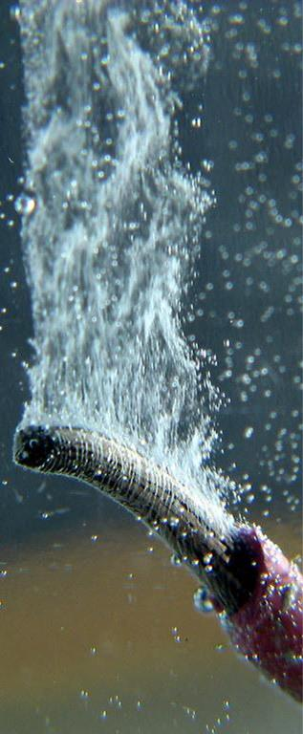
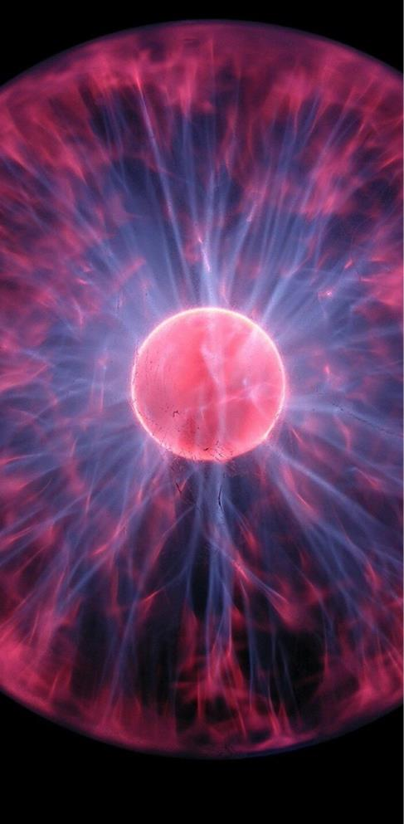
DARRELL ER (COPYRIGHTED) ©
3 variations
DILUTE
All 3 variations of electrolytic cell follows the same concept you have learnt in the previous 2 slides.
Let’s run through how the concept applies and what’s the difference between the 3 set-ups.
MOLTEN
CONCENTRATED
7

Slide 8
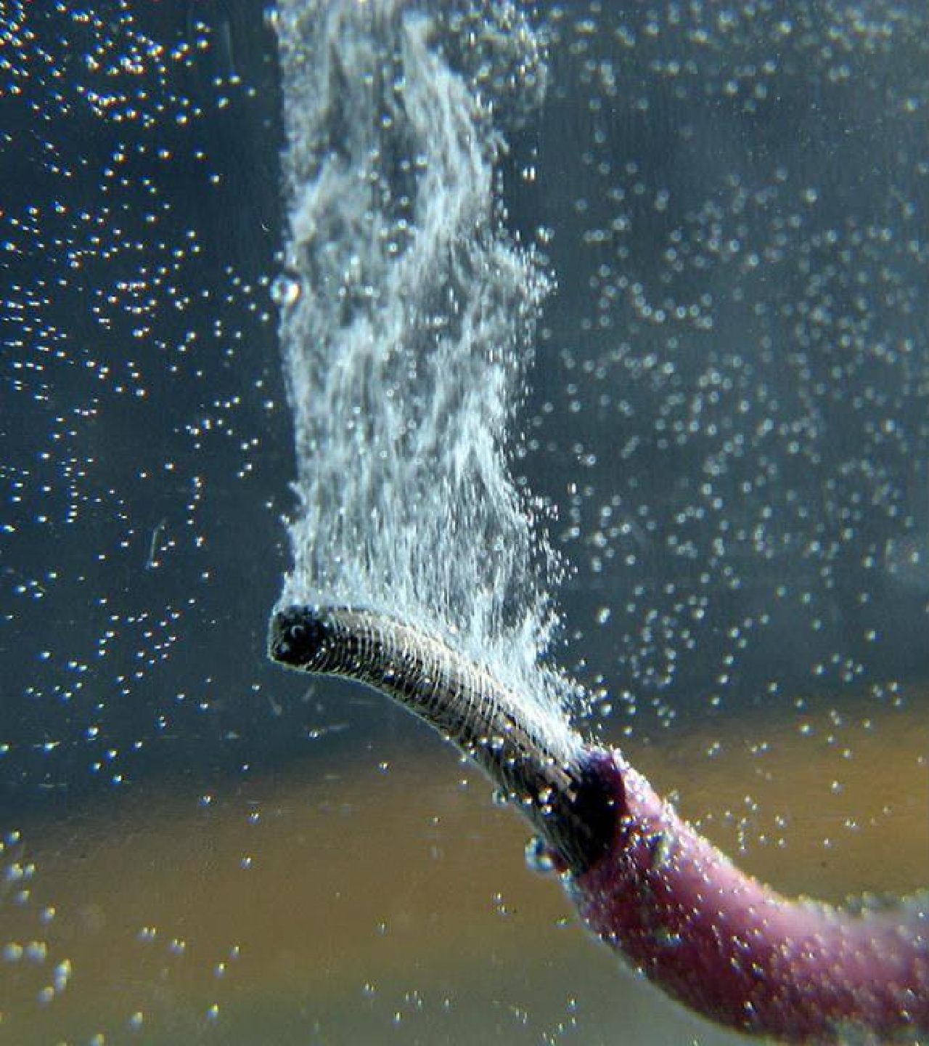



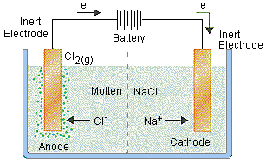

Electrolysis of molten ionic compound
DARRELL ER (COPYRIGHTED) ©
ELECTROLYSIS OF MOLTEN SODIUM CHLORIDE
Component | Explanation
Ions present | Na⁺ , Cl⁻
Observation | Tiny globules of molten sodium, a silvery liquid, would begin to form at the cathode and float to the surface. Yellow-green chlorine gas is produced at the anode which would turn moist blue litmus paper red and bleaches it.
At the anode (positive terminal) | 2Cl⁻ (l) → Cl₂ (g) + 2e⁻ Chloride ions are attracted to the anode and are oxidised to chlorine gas which will turn damp blue litmus paper red, and bleach it white.
At the cathode (negative terminal) | Na⁺(l) + e⁻ → Na (l) Sodium ions are attracted to the cathode and are reduced to globules of liquid sodium metal.
Overall change | 2NaCl (l) → 2Na (l) + Cl₂ (g) (redox reaction)
This is the most simple set up. There are only 2 ions present: Na⁺ and Cl⁻.
Cl⁻ goes to anode and gets oxidised to Cl₂ (g). Na⁺ goes to cathode and gets reduced to Na (l).
AOCR
8

Slide 9
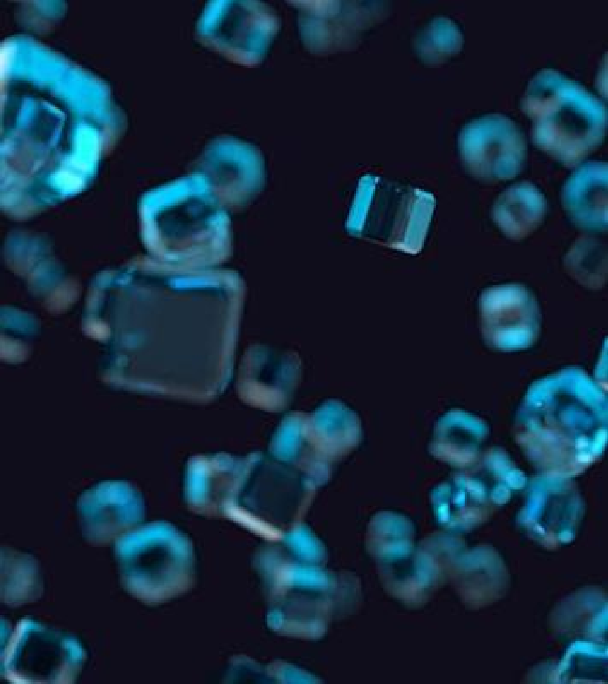

EASE OF DISCHARGE
DARRELL ER (COPYRIGHTED) ©
EASE OF DISCHARGE
Before we move on to the electrolysis of dilute aqueous
solution, we need to understand ease of discharge.
As there are usually the presence of 2 cations and 2 anions in a dilute aqueous solution, ease of discharge helps us identify which cation & anion gets selectively discharged.
For cations, the less reactive is it on the reactivity series, the more easily it can get discharged.
For anions, OH⁻ is the easiest to discharge, followed by halogens, then the common anions.
(Group VII, reactivity decreases down the group. The less reactive, the more easily it will get discharged.)
However, when it is a concentrated solution/the solution becomes concentrated, concentration effect will result in the halogens to be preferentially discharged over OH⁻ ions.
 | Cations (goes to cathode & |  | Anions (goes to anode & undergo oxidation)
 | _{K}+ |  | DILUTE | CONCENTRATED
 | Na⁺ |  | _{SO4}2- | _{SO4}2-
 | _{Ca}2+ |  | NO₃⁻ | NO₃⁻
 | _{Mg}2+ |  | _{F}- | OH⁻
 | _{Al}3+ |  | Cl⁻ | _{F}-
 | _{Zn}2+ |  | Br⁻ | Cl⁻
 | _{Fe}2+ |  | _{l}- | Br⁻
 | _{Pb}2+ |  | OH⁻ | _{l}-
 | _{H}+
 | _{Cu}2+
 | Ag⁺ | Ea
 | Au⁺ | t | he series
9
*Quick tip: For a normal aqueous ionic compound (excluding copper), H⁺ & OH⁻ is usually
the ones who get discharged.

Slide 10




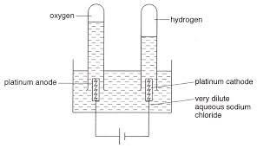
DARRELL ER (COPYRIGHTED) ©
Electrolysis of dilute ionic compound
ELECTROLYSIS OF DILUTE SODIUM CHLORIDE
Component | Explanation
Ions present | Na⁺, Cl⁻ , H⁺, OH⁻
Observation | When current is switched on, colourless hydrogen gas bubbles and is formed at the cathode while colourless oxygen gas bubbles and is formed at the anode.
At the anode (positive terminal) | 4OH⁻ (aq) → O₂ (g) + 2H₂O (l) + 4e⁻ Both Cl⁻ and OH⁻ ions are attracted to the anode, but OH⁻ is preferentially discharged and is oxidised. Oxygen gas is formed, which will relight a glowing splint.
At the cathode (negative terminal) | 2H⁺ (aq) + 2e⁻ → H₂ (g) Both Na⁺ and H⁺ ions are attracted to the cathode, but H⁺ is preferentially discharged and is reduced. Hydrogen gas is formed, which will extinguish a lighted splint with a ‘pop’ sound.
Overall change | 2H₂O (l) → O₂ (g) + 2H₂ (g) (redox reaction) Since only H⁺ and OH⁻ ions are discharged and the pH of the solution remains the same. However, the solution becomes more concentrated.
This is the most common set up. There are 4 ions present: Na⁺ H⁺, Cl⁻ , OH⁻
Therefore, we have to use the ease of discharge table to decide which ions get
preferentially discharged.
AOCR still applies. Anode Oxidise, Cathode Reduce.
AOCR
10

Slide 11
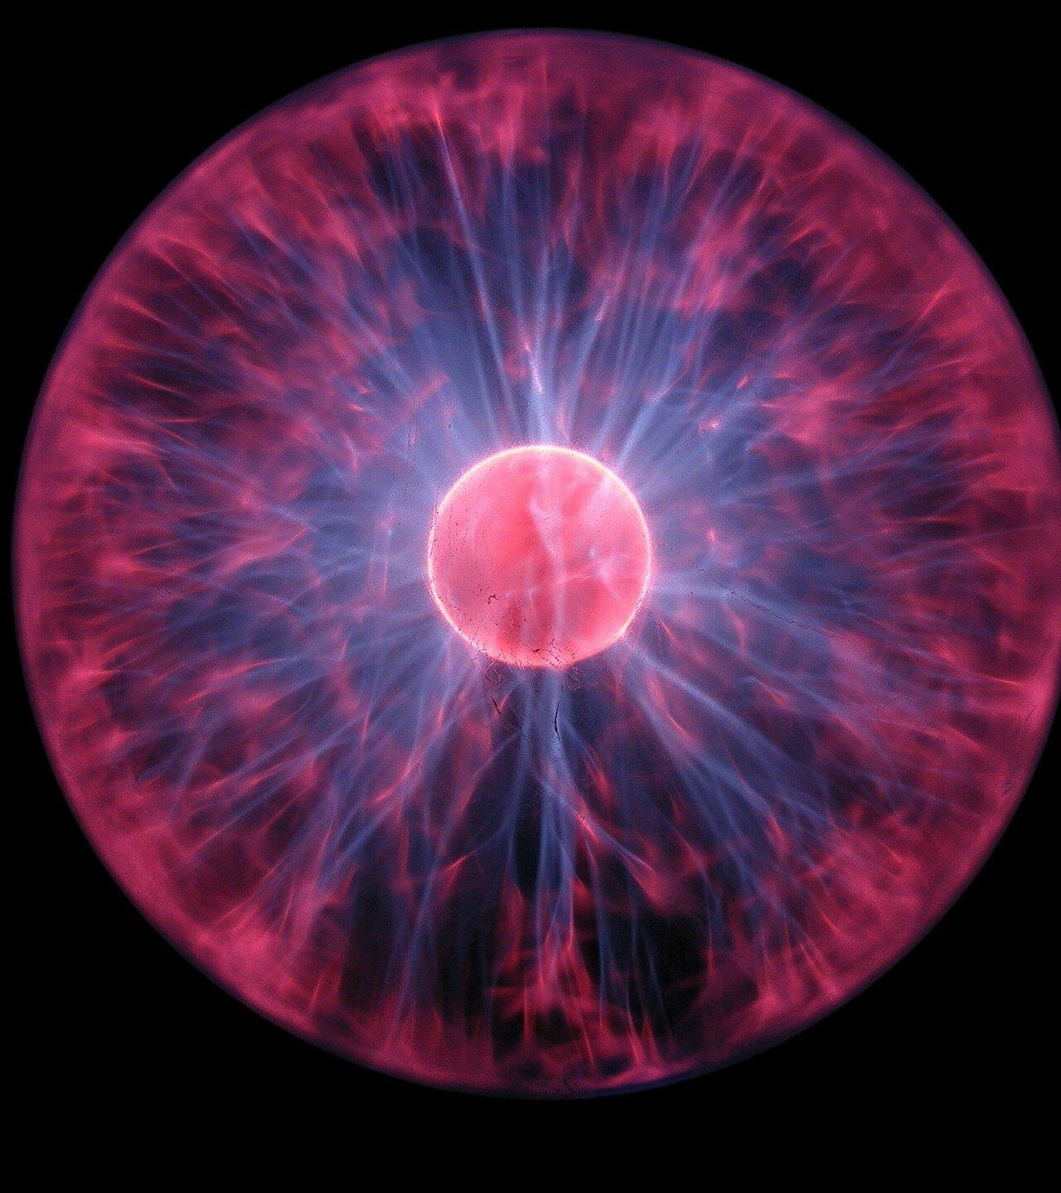




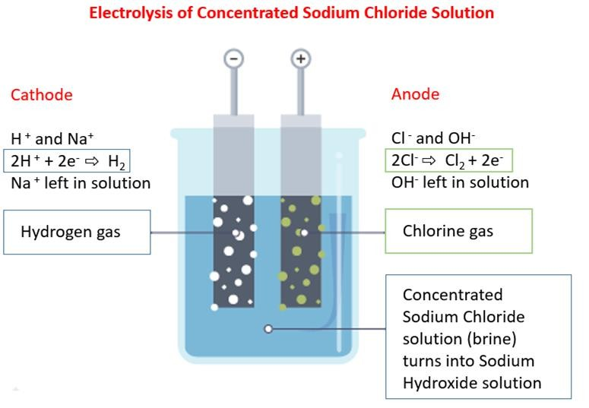

DARRELL ER (COPYRIGHTED) ©
Electrolysis of concentrated ionic compound
ELECTROLYSIS OF CONCENTRATED SODIUM CHLORIDE
Component | Explanation
Ions present | Na⁺, Cl⁻ , H⁺, OH⁻
Observation | When current is switched on, bubbling of colourless hydrogen gas forms at the cathode, yellowish-green chlorine gas appear at the anode.
At the anode (positive terminal) | 2Cl⁻ (aq) → Cl₂ (g) + 2e⁻ Both Cl⁻ and OH⁻ ions are attracted to the anode, but Cl⁻ is selectively discharged due to concentration effect, and being oxidised to chlorine gas. Bubbling of chlorine gas is formed, which will turn damp blue litmus paper red and bleaches it white.
At the cathode (negative terminal) | 2H⁺ (aq) + 2e⁻ → H₂ (g) Both Na⁺ and H⁺ ions are attracted to the cathode, but H⁺ is preferentially discharged and undergoes reduction. Bubbling of hydrogen gas is formed, which will extinguish a lighted splint with a ‘pop’ sound.
Overall change | 2NaCl (aq) + 2H₂O (l) → 2NaOH (aq) + H₂ (g) + Cl₂ (g) (redox reaction) Since Na⁺ and OH⁻ ions remain in the solution, the solution becomes more alkaline.
Anions (goes to anode & undergo oxidation)
DILUTE | CONCENTR ATED
_{SO4}2- | _{SO4}2-
NO₃⁻ | NO₃⁻
_{F}- | OH⁻
Cl⁻ | _{F}-
Br⁻ | Cl⁻
_{l}- | Br⁻
OH⁻ | _{l}-
Since this is a concentrated solution, so the ease of discharge for anions will be different.
Halogens will be preferentially discharged over OH⁻ ions. No change for cations. Still H⁺.
AOCR still applies. Anode Oxidise, Cathode Reduce.
AOCR

Slide 12

DARRELL ER (COPYRIGHTED) ©
Quick Recap
All 3 variations of electrolytic cell will result in slightly different
outcomes, however, the application of electrolytic cell remains the
DILUTE
same.
AOCR
So far, our electrodes has been inert (unreactive).
MOLTEN
CONCENTRATED
Next, let’s explore what happens when we use reactive electrodes.
12

Slide 13




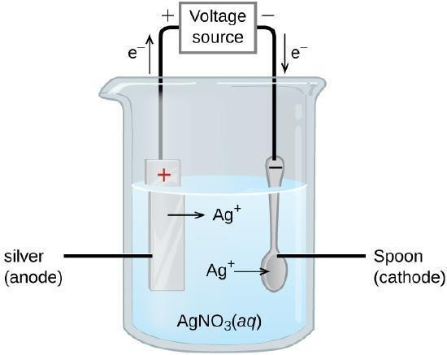
DARRELL ER (COPYRIGHTED) ©
ELECTROPLATING
Electroplating using silver electrodes
Component | Explanation
Ions present | Ag⁺, NO ⁻ , H⁺, OH⁻ 3
Observation | When the current is switched on, silver metal forms at the cathode while bubbles of colourless hydrogen gas appear at the anode.
At the anode (positive terminal) | Ag (s) → Ag⁺ (aq) + e⁻ Both NO ⁻ and OH⁻ ions are attracted to the anode, but neither of them 3 gets discharged. Instead, the silver anode is oxidised to silver ions flowing into the solution.
At the cathode (negative terminal) | Ag⁺ (aq) + e⁻ → Ag (s) As silver is below hydrogen in the reactivity series, Ag⁺ ions are selectively discharged. They undergo reduction to become silver metal which is deposited onto the surface of the object. The object becomes silver-plated.
Overall change | The object becomes silver plated and increasing in mass while the silver anode loses mass and reduce in size. The silver ions discharged at the cathode are continuously replaced by the oxidation of silver metal at the anode, resulting in the amount of silver ions in the solution remaining the same.
AOCR still applies. Anode Oxidise, Cathode Reduce.
The difference is that instead of anions from the solution getting oxidised, the silver anode (reactive) gets oxidised to form Ag⁺ ions instead.
At the cathode, Ag⁺ ions are selectively discharged and reduced back to silver
metal, which causes the silver metal to be electroplated onto the spoon.
AOCR

Slide 14
ELECTRIC CELL
SIMPLE ELECTRIC CELL
DARRELL ER (COPYRIGHTED) ©
KEY CONCEPT
14

Slide 15
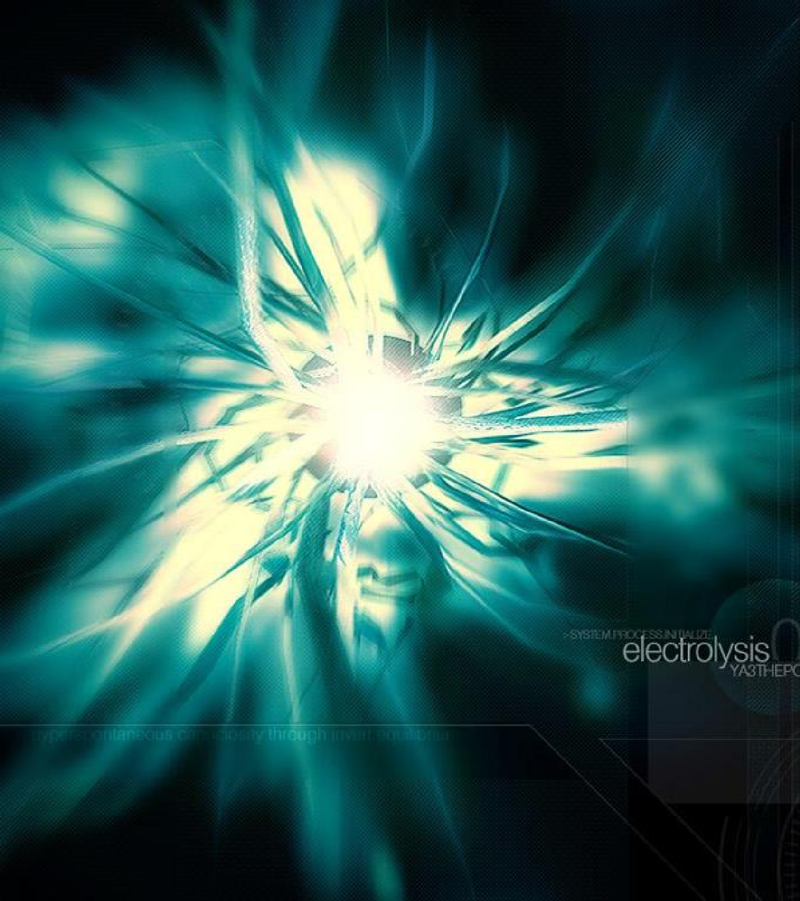

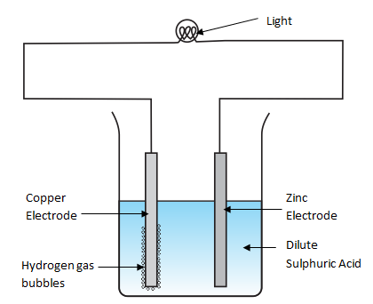

DARRELL ER (COPYRIGHTED) ©
Simple Electric Cells
SIMPLE ELECTRIC CELL
Electric cells uses chemical energy to produce electricity, unlike electrolysis, which uses electricity to cause chemical changes.
A simple, typical electric cell contains two different electrodes placed in an
electrolyte.
More reactive metal (Zinc)
The more reactive metal gives up electrons more readily and is the negative electrode. The metal is oxidised here, hence this is the anode.
Zn (s) → Zn²⁺ (aq) + 2e⁻
Less reactive metal (Copper)
The less reactive metal would be the positive electrode. As reduction occurs here, this is the cathode.
2H⁺ (aq) + 2e⁻ → H₂ (g)
electron flow
AOCR still applies. Anode Oxidise, Cathode Reduce.
The more reactive metal undergoes oxidation and gives up electrons.
The electrons then goes to the less reactive metal where reduction occurs.
Overall
The more reactive metal’s electrons would flow to the less reactive metal.
The voltmeter will detect a potential difference between the two metals.
(electricity produced)
The further apart the two metals are in the reactivity series, the greater the voltage
shown on the voltmeter or the brighter the light bulb.
AOCR
15

Slide 16
DARRELL ER (COPYRIGHTED) ©
AOCR
The one and only constant through the chapter, electrolytic cell or electric cell.
If you cannot remember anything from this chapter, the minimum is:
Anode Oxidise, Cathode Reduce.
ADVANCED
Selective discharge and Concentration effect
Take notice of which ions gets discharged for different scenarios.
Most of the time:
ANODE: 4OH⁻ (aq) → O₂ (g) + 2H₂O (l) + 4e⁻ CATHODE: 2H⁺ (aq) + 2e^{- →} H₂ (g)
But if there is Cu ²⁺ or if its molten/ concentrated, we need to apply selective discharge or concentration effect.
word of advice
Learning the basics is one thing, being able to apply and solve questions is way more important.
Leftover ions
After the respective discharge at the anode and cathode, there will be the leftover ions in the solution that did not discharge.
These ions can cause a difference to the solution.
For example, for a CuSO₄ solution, Cu²⁺ & OH⁻ gets discharged while H⁺ & SO₄²⁻ remains.
The solution turns less blue as Cu²⁺ is discharged and more acidic as H₂SO₄ remains.
Please be diligent and do some practices and see if you are
able to apply the concepts!
16

Slide 17
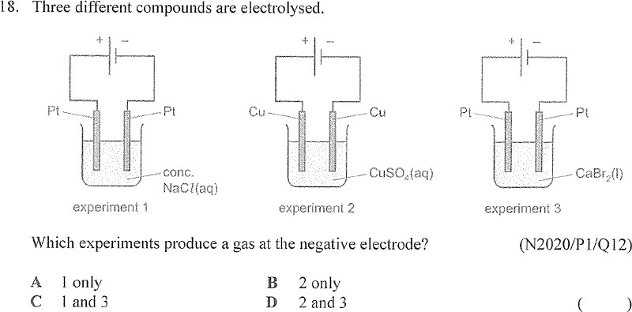
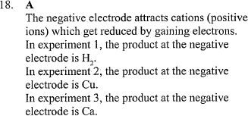
Try it yourself! (TYS Question)
Answer:

Slide 18
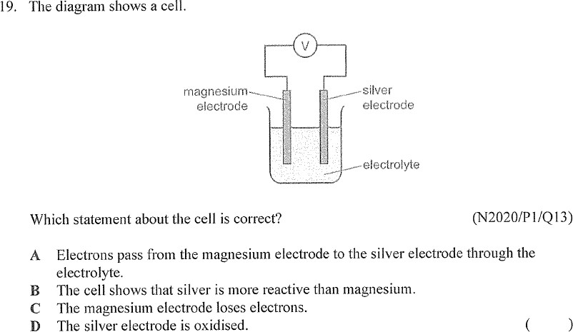
Try it yourself! (TYS Question)
Answer:

